Slide 1
Optimizing Reinsurance Decisions with Machine Learning
Cost Efficiency and Risk Management
Surabaya, 13 January 2025
Muhammad Fa’iz Ismail
JCDS -- 0412

Slide 2
Introduction
Problem Statement
Goals
TravelSafe Insurance faces high reinsurance costs due to reinsuring all policies without assessing risk levels.
This "one-size-fits-all" approach leads to inefficiencies, such as large claims being uncovered and low-risk policies being unnecessarily reinsured.
Predict the likelihood of a policy filing a claim to focus reinsurance on high-risk policies.
Identify factors driving claim likelihood to improve reinsurance strategies and risk management.
Analytical Approach
Analyze historical claims data to identify patterns and build a classification model to predict claim likelihood, enabling optimized reinsurance strategies.

Slide 3
Why Use Machine Learning
More Accurate For Prediction
Can handle historical pattern analysis of millions of claims data
Identify hidden patterns that are difficult for humans to see
Real-time prediction updates
Identification of Risk Factors
Analyze hundreds of variables simultaneously
Rank factors by importance
Real-time prediction updates
Actionable insights
Business Benefits
Cost
Reduction of unnecessary reinsurance costs
Efficiency
Reduction of unnecessary reinsurance costs
Profit
Better risk portfolio

Slide 4

Metric Evaluation
Business Metric
Reinsurance Efficiency Ratio (RER)
Interpretation
Low RER : Reinsurance risk management is more efficient.
High RER : Too many large claims are not covered by reinsurance.
Machine Learning Metrics
Type 1 Error (False Positive):
Predicting claims when there are no claims.
Impact: Reinsurance costs increase.
Type 2 Error (False Negative):
Predicting no claims when claims occur.
Impact: Large financial risk due to claims not being reinsured.
ROC-AUC as a Key Metric, minimize False Negatives with also controlled False Positives
Notes:
Menolerir FP

Slide 5
Data Understanding
Data Overview
44.238 travel insurance customers
10 columns (policies, sales, claims)
Categories
Customer Demographics:
Gender, Age, Destination
Agency
Agency (name), Agency Type,
Policy Details:
Duration, Product Name, Net Sales, Commission
Distribution:
Channel and Agency Type Analysis
Claims:
Binary indicator for modeling
Data Features
Categorical Features:
Agency: [EPX, CWT, C2B, JZI, SSI, LWC, RAB, TST, JWT, KML, ART, CCR, CSR, CBH, TTW, ADM]
Agency Type [Travel Agency, Airlines]
Distribution Channel [Online, Offline]
Product Name [Cancellation Plan, Value Plan, Gold Plan, etc.]
Destination [158 Countries]
Numerical Features:
Net Sales [-5573 to 61.0]
Commission [0 to 263.5]
Duration [0 to 503]
Age [1-118 Years Old]
Target Variable:
Claim [Yes, No]

Slide 6
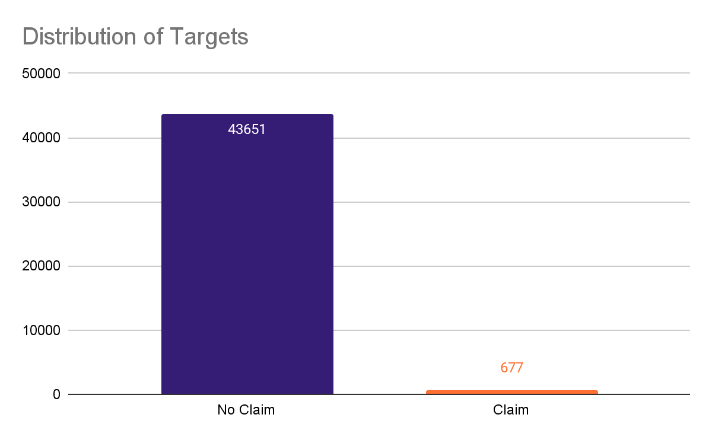
Exploratory Data Target (Claim)
Standard evaluation metrics such as accuracy may not be relevant
Special techniques are needed to handle imbalanced data
Models can be biased towards the majority class (No Claim)
98.4%
0.01%

Slide 7
Data Cleaning
1. Missing Values
From the dataset, it was found that there were quite a lot of missing values. There were 31,647 data in the Gender column, this covers about 71% of the dataset, while All other columns have no missing values ​​(0%).
Plus there is no relationship between gender variables with other variable
Finally, the deletion of the 'Gender' column was carried out, so we lost 1 feature
2. Duplicated Values
Dataset contain 5004 rows containing duplicate values. The next step is to remove it because in Machine Learning modeling, duplicate data can cause bias in the model and slow down computation
So now the dataset contain 39324 dataset with 9 feature and 1 target
3. Identify Spelling Errors
Destination has quite a large number, it is very possible that there are errors in the spelling of country names.

Slide 8
Data Cleaning
4. Identify Anomaly Values
4.1 Check Distribution (Numerical Variable)
Filtering anomalous data, namely data in the Duration column of more than 4000 days and Age of less than 100
Long-term visas such as work/study visas are usually a maximum of 2-5 years.(Reference: Schengen Visa Code)
Most travel insurances have a maximum age limit of 75-85 years. Some companies offer up to 90 years with higher premiums (Reference: AIG Travel Guard and Travelex Insurance have a maximum age limit of 85 years)
4.2 Check Cardinality (Categorical Variable)
The 'Claim' column, which is defined as the target, is very unbalanced, so a handling strategy is needed. No -> 0.982, Yes -> 0.017
The 'Destination' column has too many unique values ​​so that binning can be done.

Slide 9
Data Transformation
1. Binning (Grouping)
Destination Column:
Simplify by grouping destinations into regions:
0 = Asia, 1 = Africa, 2 = Europe, 3 = North America, 4 = South America, 5 = Oceania.
Age Column:
Group into age categories:
0 = Kid (0–17), 1 = Young (18–30), 2 = Mature (31–50), 3 = Senior (51–60), 4 = Old (60+).
Duration Column:
Categorize trip durations:
0 = <1 week, 1 = 1–2 weeks, 2 = 2–3 weeks, 3 = 3–4 weeks, 4 = 1–2 months, 5 = 2–3 months, 6 = >3 months.
2. Scaling
Net Sales and Commission (in value) Column
Apply RobustScaler or PowerTransformer due to non-normal distribution.
3. Encoding
One-Hot Encoding (Both contain 2 unique values) :
Agency Type Column
Distribution Channel Column
Binary Encoding (Contain multiple unique values.)
Agency Column
Product Name Column

Slide 10
Benchmarking
Resampling
Modelling
Oversampling
Random Over Sampler
SMOTE
ADASYN
Undersampling
NearMiss
Base Model
Logistic Regression
KNN
Tree Based Model
Decision Tree
Random Forest
Boosting Model
XGBClassifier
LGBMClassifier
AdaBoost
GBC
Specific Imbalance Model
Balanced Random Forest Classifier
Easy Ensemble Classifier
RUS Boost Classifier

Slide 11
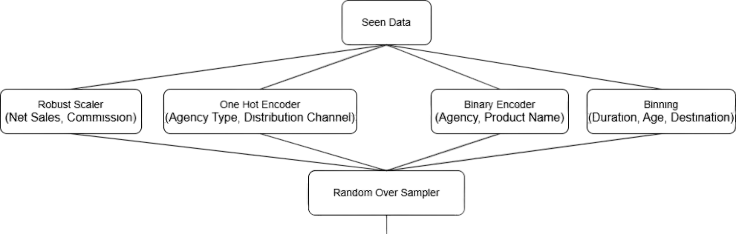
Best Model
Logistic Regression
ROC-AUC Score : 0.801 → Training dataset Stratified K-Fold
P-Value : 0,0000

Slide 12
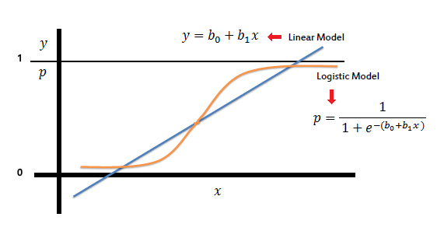
What is Logistic Regression?
How it Works?
Logistic Regression is a machine learning method used to classify data into two categories, like "yes" or "no".
It works by calculating the probability of something happening, using a formula called the sigmoid function to give results between 0 and 1.
If the probability is 0.5 or higher, the result is classified as "yes"; otherwise, it's "no".
It uses a mathematical formula to adjust and improve predictions based on the data.

Slide 13
Hyperparameter Tunning
In the hyperparameter tuning process, a parameter search space is defined to optimize the classifier model's performance. The parameters being tested are:
Regularization
C: The regularization parameter with values [0.001, 0.01, 0.1, 1, 10, 100], controlling the strength of regularization (smaller values mean stronger regularization).
Penalty: The type of penalty applied to the model's coefficients: l1, l2, or elastic net.
Solver Algorithm
Different optimization algorithms (lbfgs, liblinear, newton-cg, newton-cholesky, sag, and saga) are tested to find the optimal parameters.
Maximum Iterations
max_iter: The maximum number of iterations for model training, tested at [100, 200, 300, 500].
Multi-Class Scheme
multi_class: Specifies the approach for multi-class classification (auto, ovr, or multinomial).
Class Weights
class_weight: Handles data imbalance using the balanced scheme.

Slide 14
Tunning Result
 | Training Dataset | Testing Dataset
Before Tunning | 0.8168 | 0.8095
After Tunning | 0.8168 | 0.8091

Slide 15
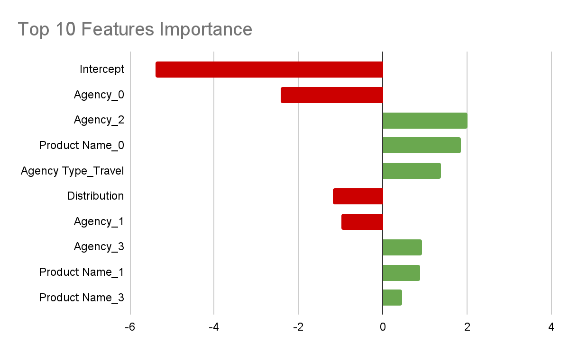
Feature Significant
All features in the dataset have a significant effect on the model.
The P-Value of all features < 0.05, which means the features are statistically significant at the 95% confidence level.

Slide 16
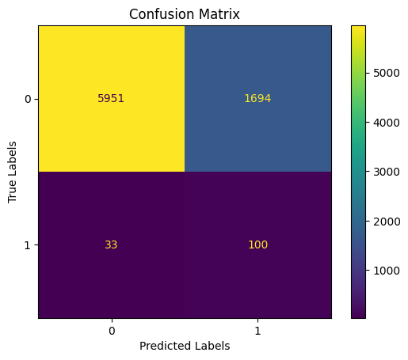
Business Calculation with New Data
Assumption :
Average premium : Rp. 291.411
Average claim = Rp. 5.000.000
Before using model
RER = ((5941 + 33 + 1694 + 100) + 0 ) / ((5941 + 33 + 1694 + 100) *5.000.000) = 0.3
Loss = (5941 + 33 + 1694 + 100) *5.000.000) = Rp.679.978.427
After using model
RER = ((1694 + 100) + 33 * 5.000.000 ) / ((1694 + 100) *5.000.000) + 0= 0.14
Loss = (694 + 100) *5.000.000) + (33 * 5.000.000) = Rp.321.837.400

Slide 17
Conclusion
Model
Business
Logistic Regression + Random OverSampler is the best combination, achieving a ROC-AUC of 0.800
Top 10 significant features:
Agency_0: Largest negative influence on claims.
Agency_2, Product Name_0: Strong positive contributors.
Agency Type_Travel Agency, Distribution Channel_Online: Highlight key behavioral insights.
Cost Savings: IDR 357,966,181 saved compared to operations without the model.
Efficiency: Reinsurance Efficiency Ratio (RER) reduced from 30% to 14.21%, improving risk management.

Slide 18
Recommendation
Model
Business
Increase data for the "Yes" class to reduce imbalance and improve model robustness.
Data Quality: Fix spelling inconsistencies in categorical features (e.g., Destination, Product Name).
Optimization: Fine-tune prediction thresholds and retrain the model regularly with updated data.
Feature Expansion: Include additional features or external data sources for better accuracy.
The model can be applied on a limited basis (pilot project) with strict monitoring.
Monitor the prediction results from this subset and use real-time data to refine the model if necessary.

Slide 19
Thanks

